Slide 1
Connect Four

Slide 2
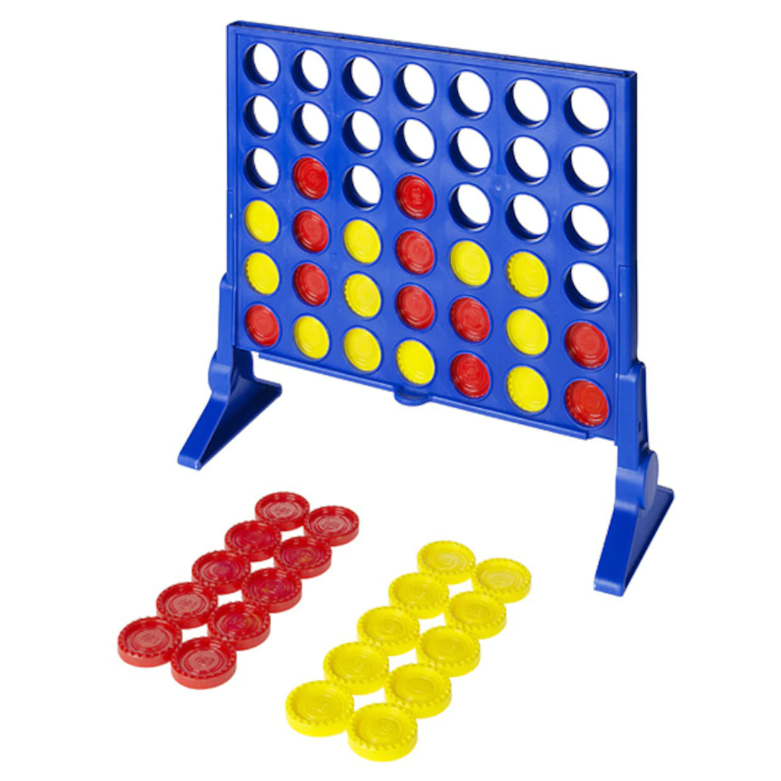
Connect Four
What Connect Four is and how it is played
How we plan on implementing our version of Connect 4 using Python.
Some of the larger components in the game and why they are important.
Some difficulties we expect to encounter and how we are planning to tackle them.

Slide 3
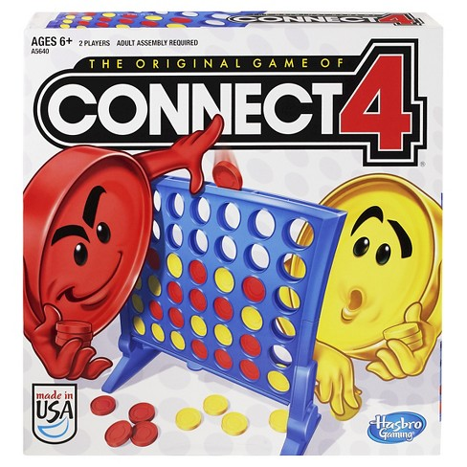
What is Connect Four
Connect 4 is a fairly simple game in which 2 players alternate dropping their own coloured discs into a 7x6 board – from the top.
Each player is trying to claim victory by connecting 4 of their pieces, either vertically, horizontally, or diagonally, before the other player can do the same.

Slide 4
4 Core classess

Slide 5
Player Class
Implentation
Attributes:
(1) Colour(String): Colour of pieces that player uses.
(2) Board(Board class): Current board status.
Method:
(1) move_left() -> None: Player moves the piece toward the left.
(2) move_right() -> None: Player moves the piece toward the right.
(3) drop() -> None: Player drops the piece.
(4) check_for_win(Board) -> Boolean: Check whether the player wins.
The implementation of the above methods will base on how board class and main class will be implemented.

Slide 6
Event Capture
In order to capture the events made by the players, there will be a while loop in the main class.
running = Ture
while running:
for event in pygame.event.get():
if event == A key or event == home key:
player.move_left()
if event == D key or event == end key:
player.move_right()
if event == space key or event == enter key:
player.drop()
if player.check_for_win(Board):
running = False.
Player in the loop is a variable representing the current player.

Slide 7
Board Class
Attributes:
(1) 2 Player Characters (each a final Strings) represents the player piece names. Called P1 and P2.
(2) Empty Character (final String) represents an empty space. Called EMPTY.
(3) Dimension for length and width (each an int). Called dim_length, dim_width.
(4) Board Grid (nested list of Strings with depth 2) represents the actual board containing represented pieces.

Slide 8
Board Class
Methods:
(1) move_left() -> None: Player moves drop spot one column to the left.
(2) move_right() -> None: Player moves drop spot one column to the right.
(3) whos_turn() -> Player: Who is making the move?
(4) drop() -> None: Player drops the piece. The player’s character is placed in the lowest empty spot in that column.
(5) check_for_win() -> Boolean: Check whether the player wins. Go through the board and see if there is a row, column or diagonal of four consecutive pieces of the same player.
(6) valid_move() -> Boolean: Check if the player’s requested drop position is in accordance to the game rules and fits in the nested list grid.

Slide 9
Board and Player classes will be the hardest implementations
Here’s why...

Slide 10
Board Consideration or Edge Cases
The Board class will have functions that address the complications of accessing and manipulating a grid.
Ex.
Checking for a ‘Connect-4’ in a corner, an edge, or the center of a board
All moves are within the dimensions of the game board
What if a player tries to drop a piece in a filled up column?
What if a player tries to break the game with invalid inputs or commands?
How can the privacy of the methods be maintained?

Slide 11
Valid_move Pseudo Code
Parameter will be the drop position(column number) of the current player playing.
If 0 <= position(int) <= dimension of columns - 1:
If there is an empty space in the column: (harder to access)
return True
Else:
return False

Slide 12
Check_for_win Pseudo Code
For every row of the grid:
For every column of the grid:
For every possible row direction according to spot:
For every possible column direction according to spot:
Follow the direction and check for four consecutive P1 or P2
If there is a ‘Connect-4’ and it belong to whos_turn: Return True
Anything else will return false.

Slide 13
Conclusion
The main workflow
Show start view from GUI class
Initialize all instance
Running main loop
Throw the result view once board class detect winner
Ask for new game ( If so, redo the inilialization)

Slide 14
Conclusion
What we have talked??
4 core classes
UI design
Call-to-Action
#Will be filled after all slides are finished

